Slide 1
Neural Circuits
Modular Spiking Neural Circuits for Mapping Long Short-Term Memory on a Neurosynaptic Processor
Notes:
Domain Specific Architecture

Slide 2
Overview
Human Brain
Von Neuman Architecture
Neuromorphic architecture
TrueNorth
LSTM
Future of cognitive computing

Slide 3
Overview
Human Brain
Von Neuman Architecture
Neuromorphic architecture
TrueNorth
LSTM
Future of Neuromorphic architecture

Slide 4
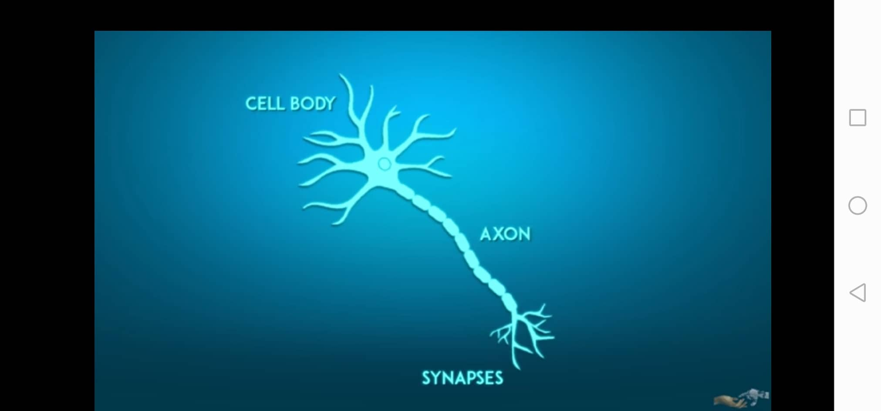
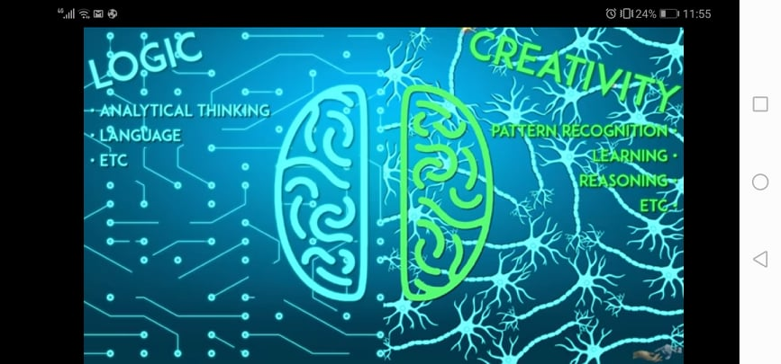
Human Brain
Structure Overview
Cell body, axons and synapses.
Left vs Right Side.
Notes:
Domain Specific Architecture
10 billion Neurons
100 Trillion synapses

Slide 5
Overview
Human Brain
Von Neuman Architecture
Neuromorphic Architecture
TrueNorth
LSTM
Future of Neuromorphic architecture

Slide 6
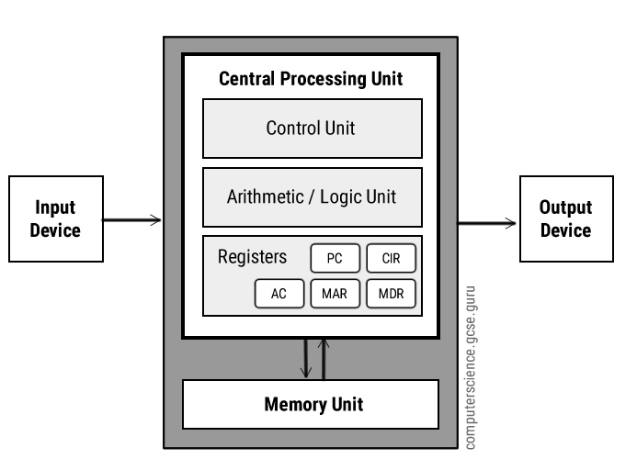
Von Neuman Architecture
Notes:
Processor Less than human brain
1700 faster than super computer

Slide 7
Von Neuman Architecture
Every computer today is based on Von Neuman Architecture.
computation and memory fairly isolated with a data bus connecting them
Biological systems have memory and processing tightly coupled together.
Pros and Cons
Neumann architecture is still the best choice for the majority of computing applications.
It does not allow us to accurately and in real time simulate aspects of the brain.
Speed relative to Brain is very low.

Slide 8
Overview
Human Brain
Von Neuman Architecture
Neuromorphic architecture
TrueNorth
LSTM
Future of Neuromorphic architecture
Notes:
Neuro- morphic

Slide 9
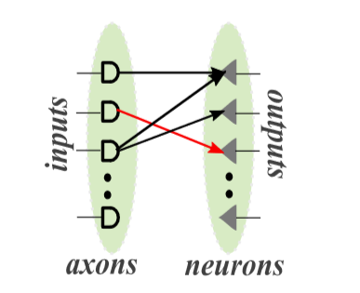
Neuromorphic Architecture
Neuromorphic architectures will allow us to accurately and in real time simulate aspects of the brain.

Slide 10
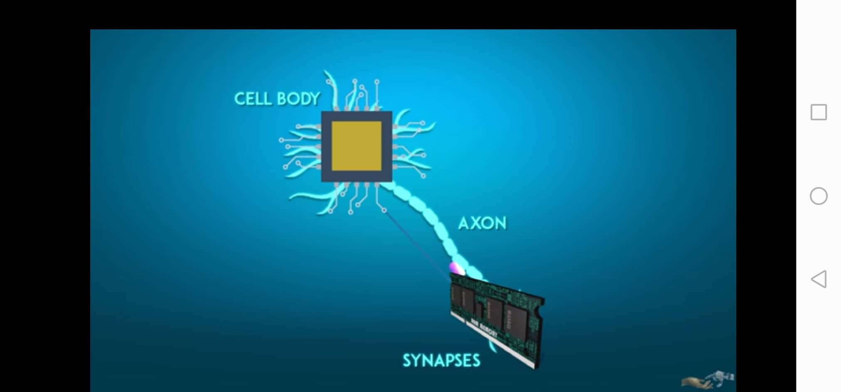
Neuromorphic Architecture

Slide 11
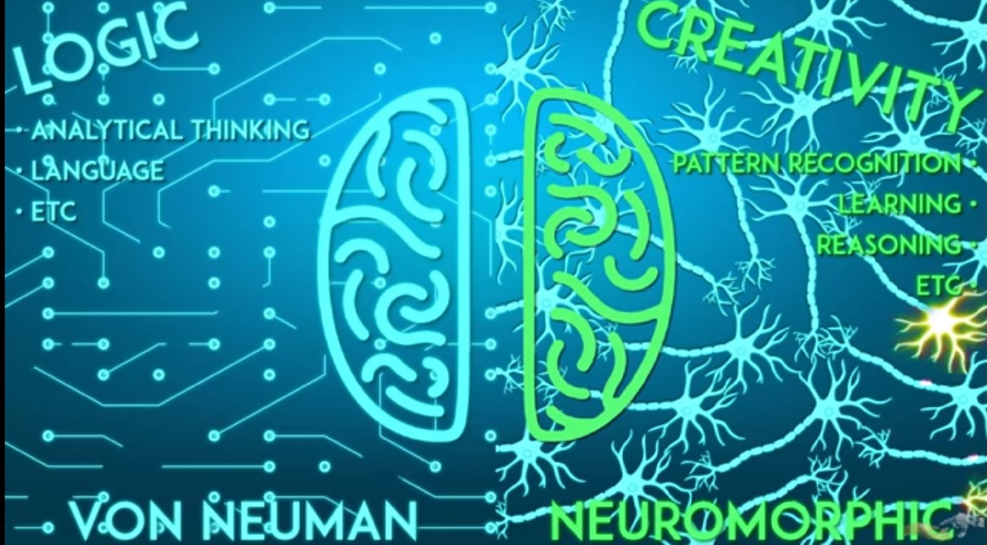
Neuromorphic Architecture
Human brain is not perfect.
Pair it with devices and accelerate the field of artificial intelligence.
Heterogeneous architecture.
Examples
IBM TRUENORTH.
Intel LOIHI.
Notes:
Take the best aspects of the brains functionality and pair them with current computing volume and architecture this all is encompassed under heterogeneous architecture.

Slide 12
Overview
Human Brain
Von Neuman Architecture
Neuromorphic architecture
TrueNorth
LSTM
Future of Neuromorphic architecture

Slide 13
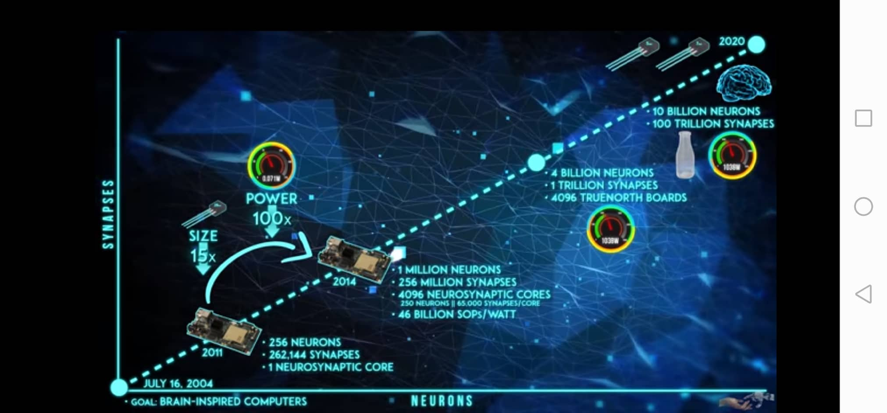
TrueNorth
By IBM
Notes:
10 billion Neurons++++
100 Trillion synapses

Slide 14
TrueNorth Circuit
Action Driven (clockless).
The communication between those neurons is in the form of spike events.
These spike events are sparse in time.
Axons as input and neurons as outputs and synapses linking.
Notes:
Remember long sequence of information In (a) 2d gradient algorithm will vanich Long short term memory for long sequence
LSTM successful in tasks like language modeling, machine translation, speech recognition, image/video captioning

Slide 15

Notes:
Event Driven fashion Time Less

Slide 16
Overview
Human Brain
Von Neuman Architecture
Neuromorphic architecture
Cognitive computing
TrueNorth
LSTM
Future of Neuromorphic architecture

Slide 17
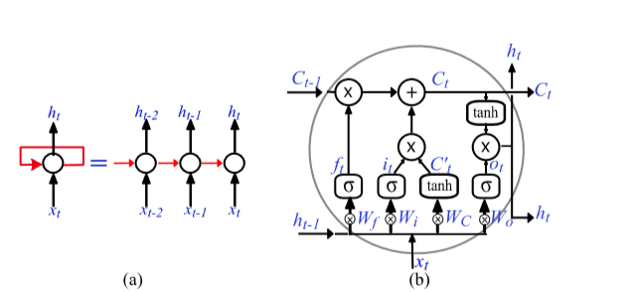
LSTM & Recurrent Neural networks (RNN)
Notes:
Forward feading :- static data
Remember long sequence of information In (a) 2d gradient algorithm will vanich Long short term memory for long sequence
But LSTM Only software LSTM successful in tasks like language modeling, machine translation, speech recognition, image/video captioning

Slide 18
Store-and-Release Mechanism
Problem :
representing this synchronization with asynchronously spiking neurons
Solution :
A store-and-release mechanism. It is implemented with special neural circuits where neurons operate in two modes, store and release.
Two internal clock signals control when a neuron enters or exits the store or release modes by applying a high negative or positive potential respectively
Notes:
Problem
Temporal Behavior of Neurons in LSTM
Store mem
Release Output
During the store mode, the neurons gate their outputs, receives input spikes and accumulate their membrane potential. During the release mode, the neurons issue output spikes at an average rate proportional to its membrane potential either stochastically or in a burst

Slide 19
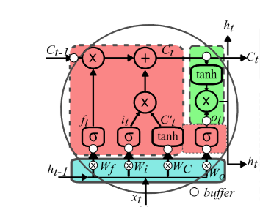
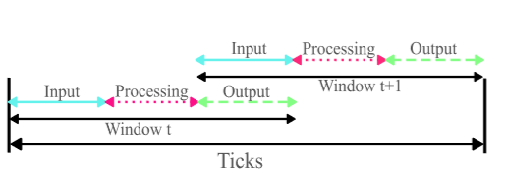
LSTM Partitions
Partitions
Input
Processing
OutPut
Notes:
The inputs to the processing partition store during the I/O phase and release in the processing phase, while the inputs to the output partition store in the processing phase and release in the I/O phase Except for the input partition, all inputs of the processing and output partitions are buffered using the store-and-release neurons processing partition spikes during the processing phase and input and output partitions spike during the I/O phases. Please note that during the I/O phase, if the output partition is working on the ith data, then the input partition is working on the (i +1)th data.

Slide 21
Experiment
We compare the Spike-based LSTM mapped on TrueNorth against the standard LSTM implemented using Keras with TensorFlow backend.
A longer phase length means high precision of the internal data of the LSTM
Notes:
We use spike-based LSTM simulated on a full precision SNN simulator

Slide 22
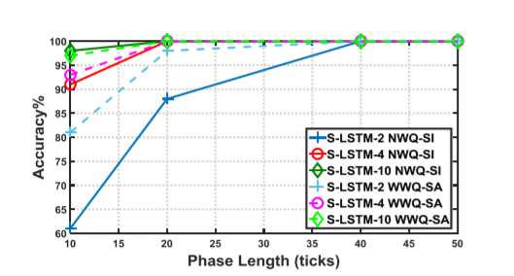
Benchmark Applications
Parity Check Problem
Question Classiﬁcation
(categorize )
Notes:
1- simpleto solvewith an RNN /The accuracy also increases when the number of LSTM units is increased we train LSTM with one hidden layer containing 2, 4 and 10 LSTM units on 9000 varying length binary sequences

Slide 23
Power Analysis
Since the active power is proportional to ﬁring activity, the event-driven nature of the architecture gives very high energy efﬁciency

Slide 24
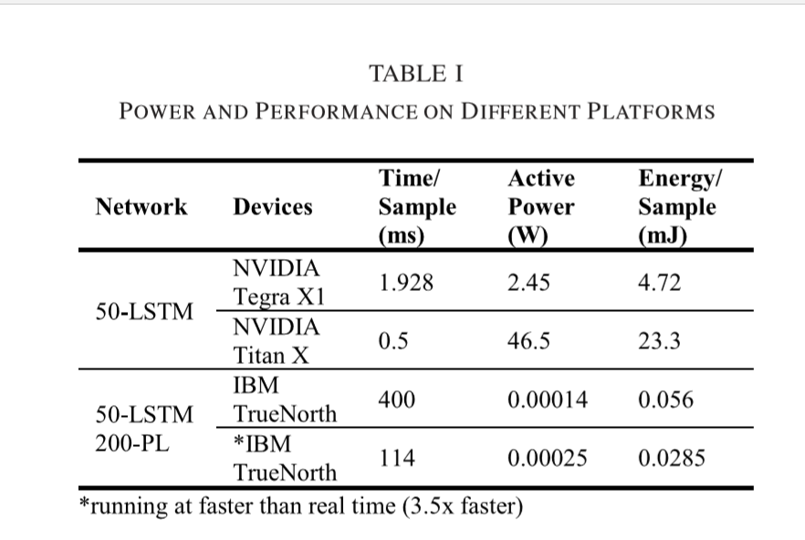
Power Analysis
Notes:
the phase length (PL)
In practical deployment, this factor of time delay is unsuitable, and it points to a large performance/energy tradeoff. This tradeoff is drastic mainly due to the inability to reliably train LSTM networks with very limited precision Can Be modified

Slide 25
Overview
Human Brain
Von Neuman Architecture
Neuromorphic architecture
Cognitive computing
TrueNorth
LSTM
Future of Neuromorphic architecture

Slide 26
Memristors
Type of SNN, By HP.
Works exactly like the brain in terms of memory and processing on the same level.
In-memory computation.
Avoids data fetching.
Able to mimic brain operations.
Matrix Operations (like Machine Learning).
lead a 100,000 times greater throughput in Machine Learning.
Can be used to simulate senses using analog and digital inputs.

Slide 27
Future
brain stimulation
will aid us in better understanding our bodies and mind
leads to developments in mental health initiatives and neurological disorders.
Alzheimer's and ALS.
AI
Could mimic brain functions with high and efficient energy.
Notes:
Undurtand bilogical ALS تشنجات

Slide 28
Any Question ?

Slide 29
References
Modular Spiking Neural Circuits for Mapping Long Short-Term Memory on a Neurosynaptic Processor
What Is Neuromorphic Computing

Slide 30
THANKS :D
Aya Ashraf and Sohayla Mohammed

